Slide 1
Algorithmic Accountability &
Transparency
JOUR479V/779V – Computational Journalism
University of Maryland, College Park
Nick Diakopoulos, Ph.D.

Slide 2
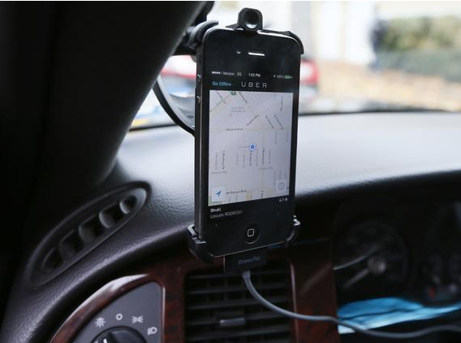
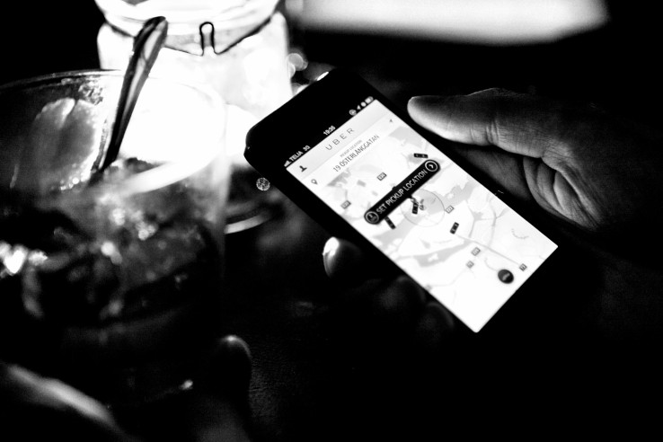
Notes:
Describe the service and how it works, discuss some of the advantages: better prices, more supply, more convenience for users, and disadvantages: sidesteps some regulation (lawsuit over blind passengers), makes it hard for drivers to negotiate b/c they are indep contractors.
Very apro po to talk about Uber in France where it’s very controversial.

Slide 3
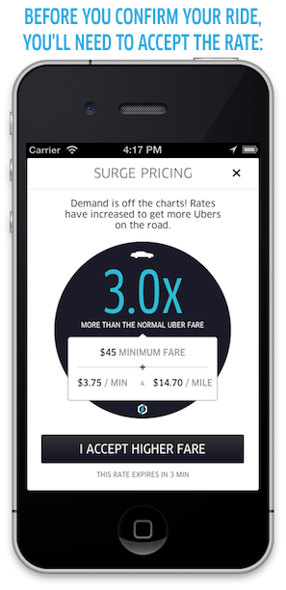
Notes:
Talk about surge prices, and how they are algorithmically dictated. The algorithm tries to manipulate the price to stimulate more drivers to come out as well as to control the demand for the product.
Broaden out to other peer sharing platforms: things like Airbnb also use algorithms: it’s about trying to optimally match buyers and sellers in an algorithmically mediated market. The problem is that we have no idea how those algorithmsm are working.

Slide 4

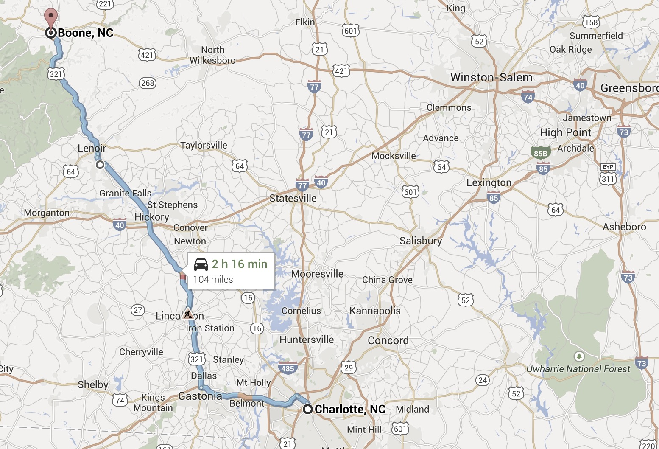



Do surge prices even work? If so, how?
Notes:
Why does this investigation matter? We want to know about potential price discrimination that the algorithm might facilitate. We want to know whether some neighborhoods have better service than others, and if there are correlations to socio economics.
The worry is that the worst served neighborhoods have the least supply of uber vehicles, which might lead to higher surge prices and an deleterious feedback loop which drives prices even higher in those neighborhoods.
What do surge prices depend on?
Weather?
Location?
Supply?
Length of trip?
User profile or history?
Other factors?
Do surge prices even work to get more supply?
How can we investigate this algorithm?

Slide 5
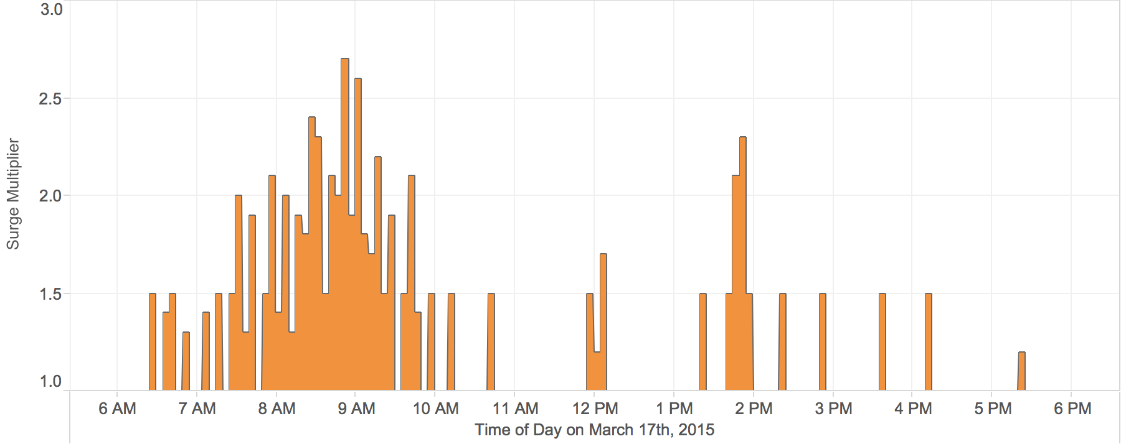
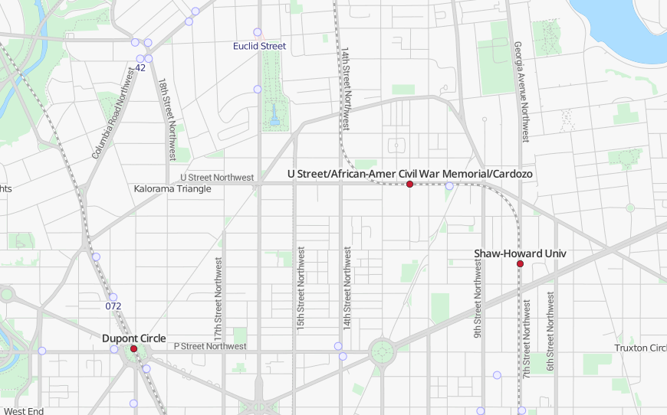
Notes:
So back to the original question of whether uber surge pricing actually works.
I collected 4 weeks worth of data from Ubers own api and started asking questions, like how often does the price actually change? You can see neighborhood level patterns, as well as spikes.

Slide 6
Readings
How Uber Surge Pricing Really Works
What is some of the evidence cited in the article for how the surge pricing algorithm works?
Notes:
Prices change very frequently making it unlikely that drivers can react to prices -> Not working as claimed
Estimated wait times do decrease within a few minutes of a surge in the area -> working as expected
Appears to redistribute drivers from one area to another

Slide 7
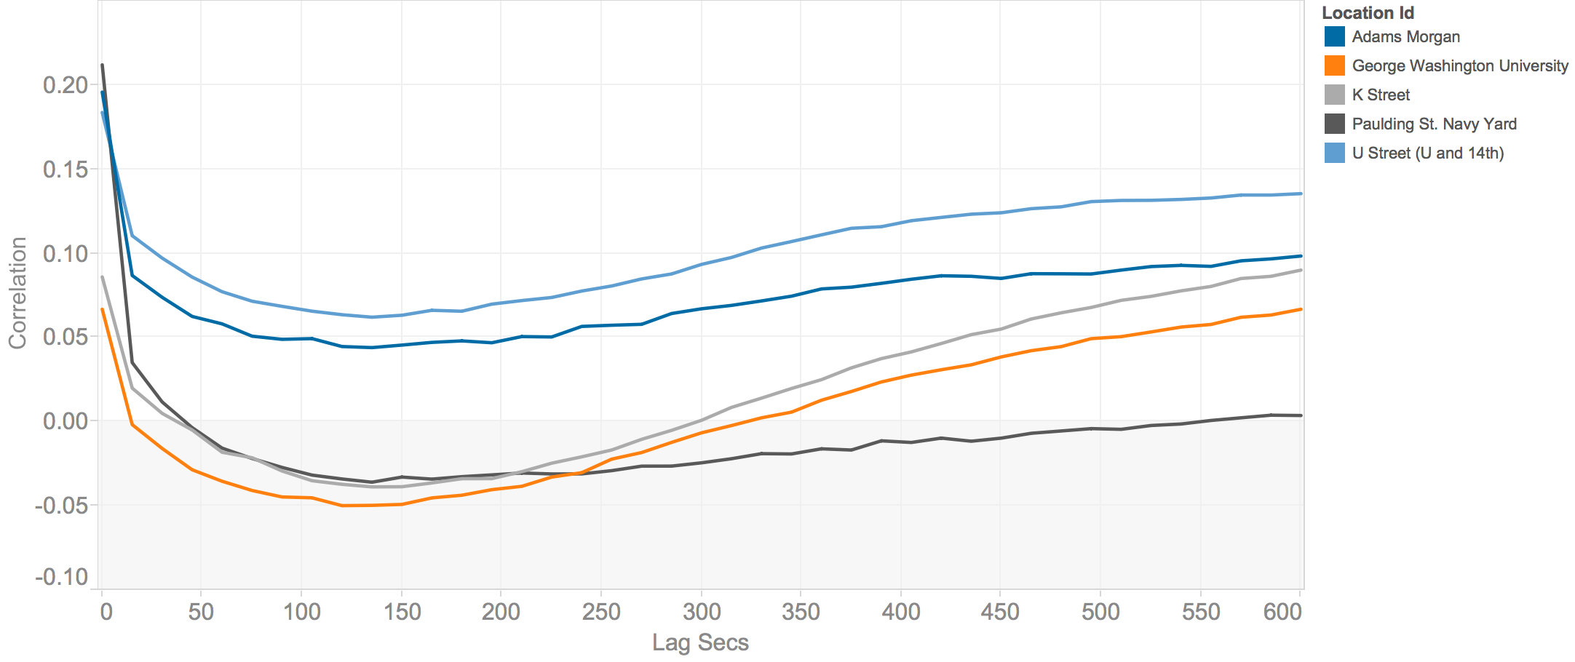
Prices and Wait Times
Notes:
The service quality at a given location can be roughly measured as the estimated waiting time for a car. The less cars are within range of a rider, the longer that rider has to wait to get picked up, and the worse their experience.
If the Uber system is working as advertised we would expect price surges to come into effect to keep estimated waiting times in check as demand increases. The next graph shows how estimated waiting times correlate to changes in prices after some amount of time has passed for drivers to react.
The chart shows that in some locations an increase in price led to decreased estimated waiting times within a minute or two, such as in the Navy Yard, George Washington University, and K St. areas. But on U St. and Adams Morgan, the response was more muted: several minutes after a price spike the wait times were still going up, albeit less severely. The evidence here is mixed. The pricing system is working to reduce estimated wait times, but it seems to be working better in some neighborhoods than in others.

Slide 8
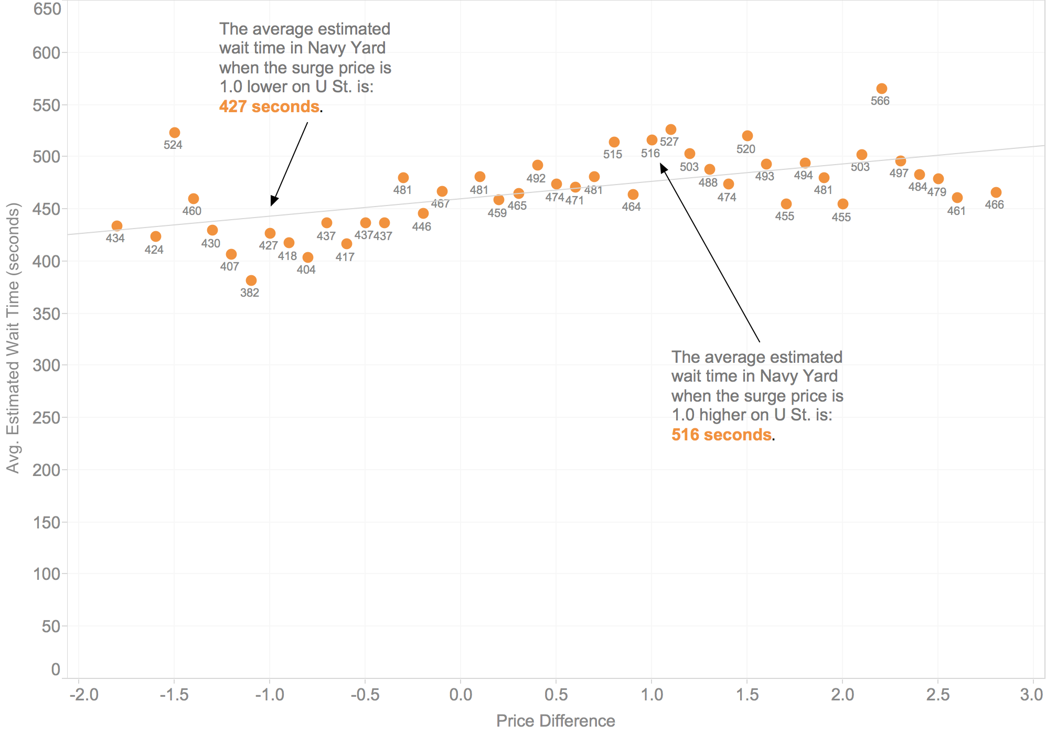
Notes:
So the pricing algorithm seems to work somewhat for reducing wait times for cars when surge pricing kicks in. But the pricing is highly localized and is changing frequently. Is it really getting more cars on the road, or is it attracting drivers already on the road toward neighborhoods with surge prices? The data in fact suggests the latter: when prices are higher in one neighborhood it saps capacity away from an adjacent neighborhood. For instance, if surge pricing is higher on U St. or K St. I found that the estimated waiting time, the service quality, suffers in the Navy Yard. As the next chart shows, if the price is 1.8x higher on U St. than in Navy Yard this means a rider in Navy Yard would have to wait on average 40 seconds longer for a pick-up.
Instead of getting more drivers on the road, Uber’s surge pricing appears to deplete drivers in adjacent areas. A price hike in one area means drivers move there, but away from another, leaving it underserved. If someone in the newly underserved area now needs a car they wait longer, or a surge price has to come into effect to get a car over there. At the end of the day the Uber system is about re-allocation of supply. And this raises interesting questions about which neighborhoods “deserve” to have higher service quality. Higher prices for some means worse service quality for others.

Slide 9
IRS Audits
Fraud Detection
Political Messaging
Urban Planning
Credit Scores
AirBnb Pricing
Predictive Policing
Yelp Reviews
Copyright Infringement
Student Matching
Net Neutrality
Comment Moderation
College Rankings
Twitter Trends
Advertising
Government Censorship
Welfare Management
News Personalization
Automatically Generated Content
Teacher Rankings
Romance & Dating
Criminal Sentencing
Search Rankings & Completions
Human Resources
News Layout
Recommender Systems
Notes:
Slide with word cloud: The basic idea here is that not just in romance, but in many walks of life we’re now turning over important decisions to algorithms. Point out some of these examples and perhaps provide a sentence of context.
Why this matters for journalism is that these algorithms wield an increasing amount of power over us, but we have little clarity over how they operate and exert that power.
Interesting to mention: http://mobile.nytimes.com/2014/08/11/opinion/sentencing-by-the-numbers.html?referrer=&_r=3

Slide 10
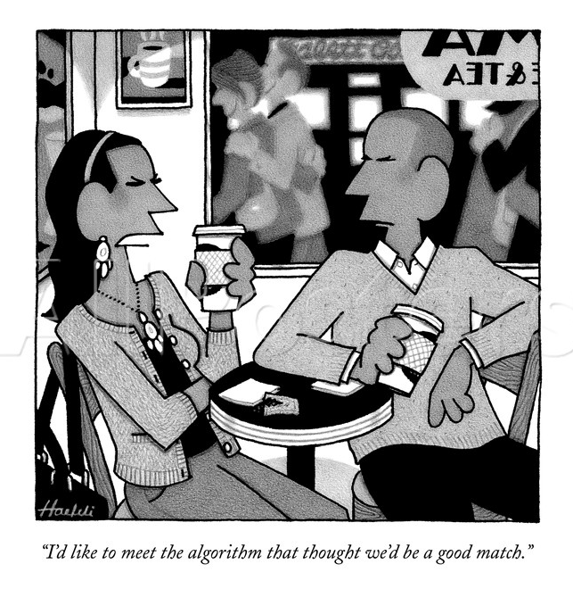
Notes:
There are even algorithms in things like romantic dating, which this clever New Yorker cartoon captures. Actually it’s quite astute, you have an annoyed woman who says: “I’d like to meet the algorithm that thought we’d be a good match.” which kind of drives at an underlying issue with algorithms which is that they’re not accountable.
We don’t really know HOW they came to their decisions: whether that be a romantic match, or a search ranking, or what have you.

Slide 11
Algorithmic Accountability
How to investigate algorithms that are use in media, government, or industry?
How can we characterize the bias, power, or influence of an algorithm?
What role might journalists play in holding algorithmic power to account?
N. Diakopoulos. Algorithmic Accountability Reporting: On the Investigation of Black Boxes. Tow Center Report, Columbia University. Feb., 2014.
Notes:
Which brings up a need to think more about algorithmic accountability: an emerging new dimension of investigative journalism that makes algorithms its focus and asks questions like …
We might employ methods like reverse engineering of an algorithm’s input-output relationship, or auditing to help characterize adapative and personalized algorithms
Now news orgs are also corporations that operate algorithms. What does it mean to have such an algo operating internally to a news org?

Slide 12
Prioritization
Classification
1
2
3
Association
Filtering
Notes:
Algorithmic Power: decisions
Where does algorithmic power come from? Algorithms derive their power through the scale of their ability to make decisions over quantified data - give a couple examples
The crux of algorithmic power is really autonomous decision-making. We might start to assess algorithmic power by thinking about the atomic decisions that algorithms make. And they can be composed and composited to arrive at higher level operations like summarization. This framework can help identify what we might focus on when investigating an algorithm, and suggests questions: criteria, errors, biases in training data, editorial criteria.
Prioritization: fire-inspections in new york. Parollee attention, net neutrality
Classification: contentID – infringing or not
Association: google auto complete
Filtering: Censorship on social media – e.g. chinese censorship or the filtering of child pornography from search results

Slide 13


Notes:
Yelp: Example of an algorithm affecting the market and business.
Nice tag line “real people, real reviews” except that the problem is that sometimes they’re not real reviews, or they are, but Yelp doesn’t think they are.
Yelp employs an automated filter that tries to categorize whether a review is legitimate or not. As in the screen cap, the filtered reviews “are not factored int the businesses overall start rating”

Slide 14

16% of reviews filtered as fake
An Imperfect Filter
De-emphasize Legitimate Reviews
Leave Fake Reviews Intact
+1
5-9% increase in revenue
Notes:
So a categorization algorithm like they use can make mistakes. It can make false positive (reviews that are legit but that are filtered out) and false negative (reviews that are fake but that are left intact). These errors can be tuned in different ways.
The essential business concern is that if the errors happen to leave more deleterious reviews intact while removing their better reviews it can affect their bottom line. Research has shown that a 1 start increase in reviews on yelp can increase business revenue by 5-9%
This has led to allegations that Yelp may be intentionally manipulating this in order to get businesses to buy advertising.

Slide 15
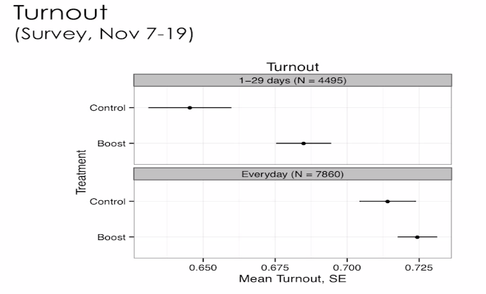
Facebook News Exposure
Credit: Solomon Messing, Facebook
Notes:
There’s another place where people are also getting political information
1.9M people in study Aug – Nov 2012. 12.3k responses to post-election survey
Tweak news feed – if any of your friends had shared a news story would boost so it was up top and more likely to see. Then survey 12k and ask how much they follow govt – ppl more interested in politics after being more exposed to more news. It was also shown to boost self-reported turnout voting “more likely to say they had voted” – had a stronger effect on people who were more ocassional in loggin in b/c ppl logging in everyday were already on the upper end of exposure.

Slide 16
Input-Output of an Algorithm
Input
Output
Notes:
So now that we’re seen some of the potential impacts of algorithms in online media, civic life, and commerce, let’s talk about how we might actually go investigate and make sense of algorithmic power.
Algorithms may be black boxes, but they have two little holes in the side, one for inputting and one for outputting. And if you vary the inputs in enough different ways and pay close attention to the outputs, you can start piecing together a theory of how the algo works.

Slide 17
WSJ Price Discrimination
Do different people pay different prices depending on their geography or browser history?
Staples.com
Geo
Cookies
Prices
Jennifer Valentino-DeVries, Jeremy Singer-Vine, and Ashkan Soltani. Websites Vary Prices, Deals Based on Users’ Information. Wall Street Journal. Dec, 2012.
Notes:
At the WSJ they used reverse engineering to understand how online commerce sites like Staples dynamically set prices based on things like geography and browser history. This involved simulating thousands of surfing sessions and recording prices.
Also: rosetta stone, orbitz, home depot

Slide 18
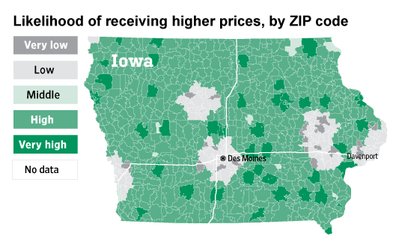
Notes:
The tendency to see discount prices appeared to be tied most strongly to distance from an OfficeMax or Office Depot — Staples' main competitors.
• ZIP Codes within about 20 miles of a competitor's store tended to see discount prices.
• ZIP Codes farther away from a rival store tended to see higher prices, even more so if the ZIP Code contained a Staples store.
• Cities (which were more likely to have Staples stores as well as competitor stores) tended to see discount prices in the Journal's tests as well.
• The Journal also examined numerous other possible factors, including income and race, and found that none were tied as strongly to price as competitor-store locations.

Slide 19
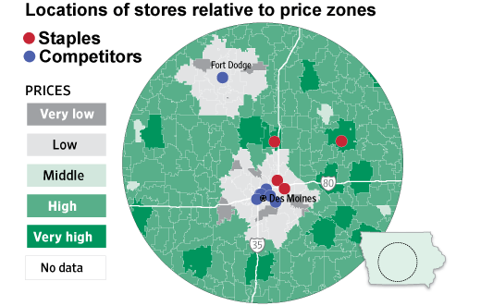
Notes:
The tendency to see discount prices appeared to be tied most strongly to distance from an OfficeMax or Office Depot — Staples' main competitors.
• ZIP Codes within about 20 miles of a competitor's store tended to see discount prices.
• ZIP Codes farther away from a rival store tended to see higher prices, even more so if the ZIP Code contained a Staples store.
• Cities (which were more likely to have Staples stores as well as competitor stores) tended to see discount prices in the Journal's tests as well.
• The Journal also examined numerous other possible factors, including income and race, and found that none were tied as strongly to price as competitor-store locations.
What they found is that statistically speaking, the strongest correlation to price involved the distance to a rival’s store from the center of a zip code. Prices tend to be higher in areas with less competition, including rural or poor areas.

Slide 20
Readings
Websites vary prices, deals based on Users’ Information
Is is fair to discriminate in terms of prices to different people based on their location? What are pros / cons?
Notes:
Driving prices down through competition could be a good thing
Location correlates with other demographic factors like income and race so you might incidentally discriminate racially

Slide 21
Six Stories about Algorithms
1. Discriminatory / Unfair
2. Mistake that denies a service
3. Censorship
4. Breaks law or social norm
5. False Prediction
6. Violation of privacy
What are consequences of algorithm to public, or personal interest? Significance? Number of people affected?
Notes:
Point is to step back and say that for any of these research methods we want to try to uncover interesting and newsworthy stories, which starts to point towards a general skepticism about what algorithms might be doing that’s not in our interests.
So what might make a story out of an algorithm? Maybe it’s discriminatory or unfair in some way. It makes a mistake that denies a service. It censors something. It’s output breaks a law or social norm. Or it falsely predicts something with real consequences.

Slide 22
Auditing Challenges
“Proof” is Elusive
Lack of internal knowledge of systems
Interviews are important but can be adversarial
Legal and Regulatory Issues
Terms of Use, EULAs, DMCA, Computer Fraud and Abuse Act
FOIA: trade secrets, no document creation
1992 Federal Highway Administration case
Ethical Implications
Publication & gaming, individual privacy, deception
Notes:
For FOIA: mention that it has been used to compel source code disclosure, and that it ultimately won out in against the FHA for calculation of carrier safety ratings; also mention the FOIPA idea and the need to rethink it to include audit trails.
in 1992, the Federal Highway Administration resisted disclosing the algorithm it used to compute safety ratings for carriers, but ultimately lost in court to a plaintiff that successfully argued that the government must disclose the weighting of factors used in that calculation

Slide 23
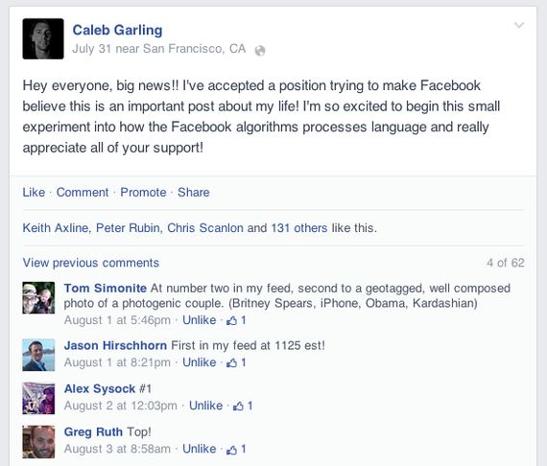
Notes:
There may be simpler alternatives to understand algorithms: you can poke and prod algos around you.
Talk about FB as a curated news feed, that some are starting to poke and explore what triggers it: http://www.theatlantic.com/technology/archive/2014/08/tricking-facebooks-algorithm/375801/ -
There was another interesting story to mention from Wired, about the writer liking everything for 2 days and the feed getting totally polluted: http://www.wired.com/2014/08/i-liked-everything-i-saw-on-facebook-for-two-days-heres-what-it-did-to-me/

Slide 24
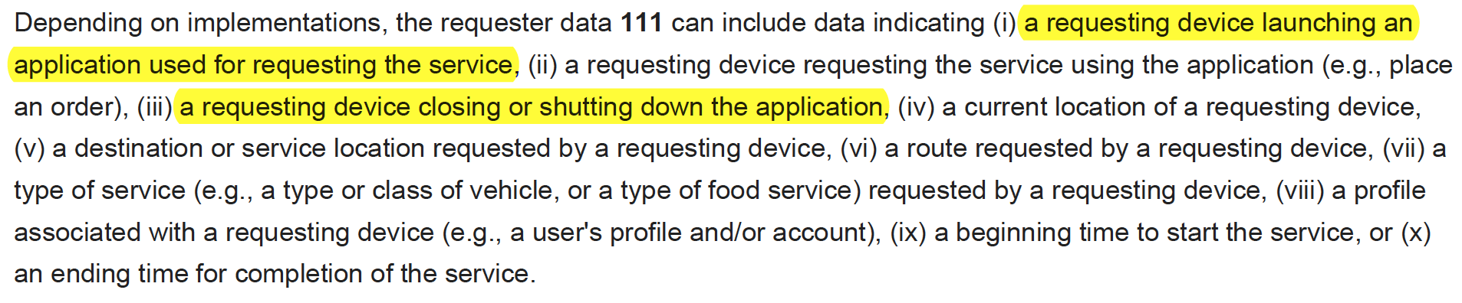
Experiment!
Can we induce an artificial surge on campus?
Close the Uber app if it’s running in the background
Everyone re-start it on my signal, leave it open
But do NOT request a car!
Notes:
Note: READ THE PATENT

Slide 25

Algorithmic Transparency

Slide 26
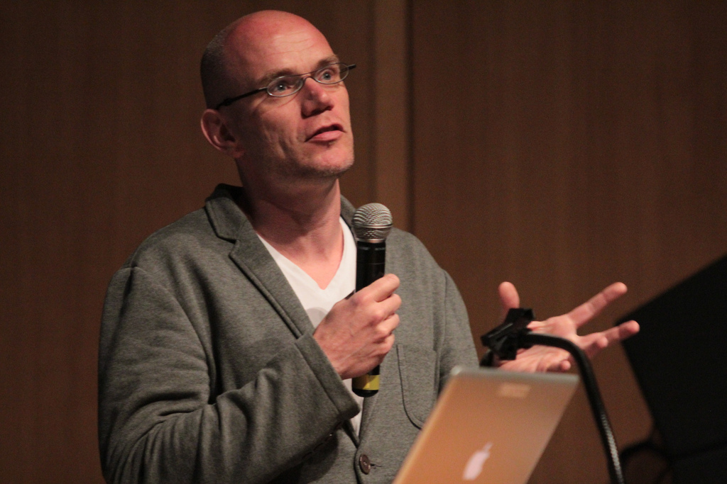
Transparency is defined as “the ways in which people both inside and external to journalism are given a chance to monitor, check, criticize and even intervene in the journalistic process.”
– Mark Deuze, University of Amsterdam

Slide 27

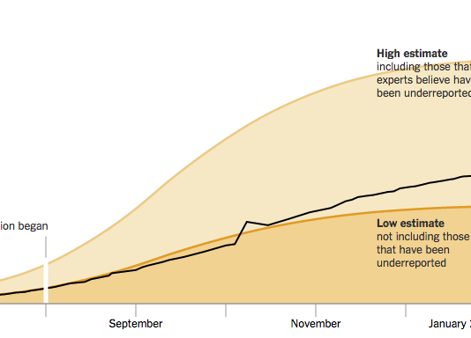

Algorithmic Transparency Workshop
Automated News Content
Algorithmic Curation
Simulation & Modeling
What could be made public about an algorithm?
What are limits of algorithmic transparency?
What are comprehensive disclosure mechanisms?
Notes:
Convened about 50 people at Tow Center to talk through case studies and examine what we might make transparent. Transcribed all sessions and analyzed qualitatively.

Slide 28
Towards a Transparency Standard
Human Involvement
Data
3. Model
4. Inference
5. Interface
I/O
Pipeline
Notes:
A chance to advance the deontological ethics of algorithms by suggesting standards for what might be disclosed. One study suggested that professional codes of ethics had one of the largest impacts on journalist behavior (50%).
There were broadly 5 areas that people felt would be interesting to have more transparency.
The role of humans in these processes was something that came up over and over.

Slide 29
Towards a Transparency Standard
1. Human Involvement
Goal / purpose / intent? Who has oversight? Who are authors?
If third party, how configured / parameterized?
The “Algorithmic Presence”: whether an algorithmic process was being employed at all. Personalization? A/B testing?
“What is the baseline here and what are we expecting of algorithms that we don’t expect of human writers?”
Notes:
Can we ever really disentangle the roles and decision of humans versus algorithms in specific algorithmic systems?

Slide 30
Towards a Transparency Standard
2. Data
What’s input to the system?
Data quality (accuracy, completeness, uncertainty, timeliness); sampling method; variable definitions; provenance (sources, public or private); volume of training data; assumptions in collection; inclusion of personally identifiable information
“You want to see the data profile that they’re using on you that the algorithm is reacting to.”

Slide 31
Towards a Transparency Standard
3. Model
Input scheme: variables / features; target variables for optimization; feature weightings; name or type of model; software modeling tools; source code or pseudo-code; thresholds or embedded rules
Differences in “editorial” human choices affecting model, and implementation decisions

Slide 32
Towards a Transparency Standard
4. Inference
Classifications, numerical predictions
Existence of inferences at all; accuracy of classifications and predictions (FP, FN rates); benchmarks to standard datasets; Error / failure analysis; Uncertainty and confidence values
“The algorithms is making assumptions about who you’re closest to or what content you want to see and those inferences may not be completely accurate.”

Slide 33
Towards a Transparency Standard
5. Interface
Face presented to end-user
Algorithmic presence; on / off indicator; tweakability of inputs or weights and comparability of outputs
Directly integrate transparency info in UI? Transparency reports?
“…the thing that I struggle with is coming up with a way to not add to the overload hwen we’re helping people understand.”
Notes:
One promising path forward is to align information disclosures in a way that enhance the user experience.
But other forms of transparency information are less relevant to the immediate UX and more for broader public: censorship, bias in attention.

Slide 34
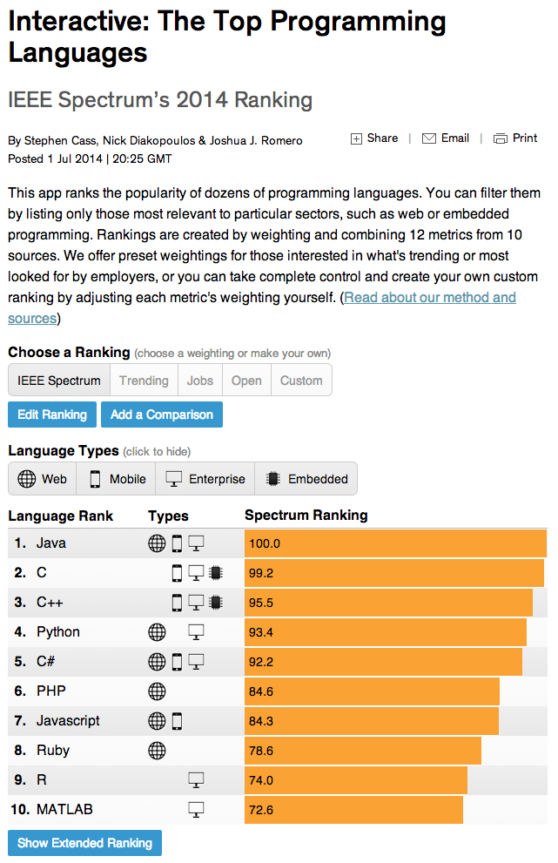
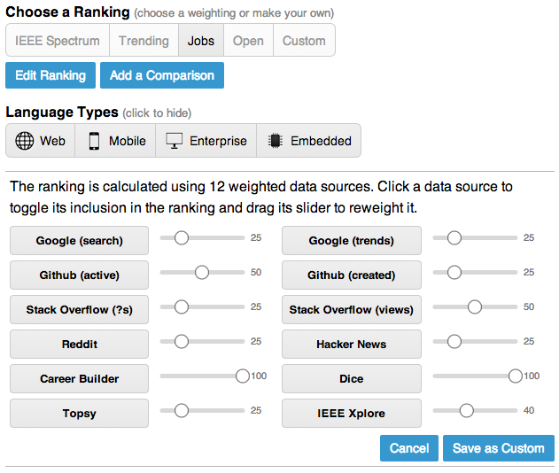
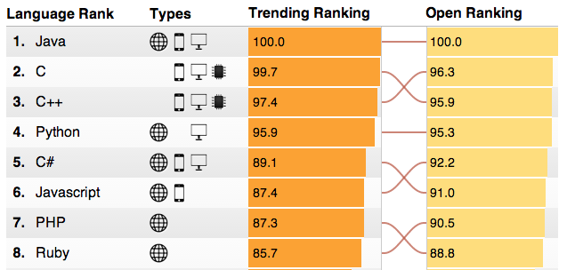
Notes:
Connect back to challenge of transparency and how to make progress on that.
About 1 in 6 people tweaked the ranking in various ways.
Other presentation possibilities could include an algorithmic transparency report, or use NLG algorithms to explain how a decision was reached.

Slide 35
Transparency Challenges
Business Concerns
Costs of information production (data prep, documentation, benchmarking)
Privacy issues
Legal concerns over admitting errors / uncertainties
Trade secrets / competitive advantage
Cognitive Complexity
Transparency information needs to be accessible and understandable
“If it’s detailed enough for somebody to understand the science of algorithms to really use critically, maybe 1 percent of the readership would be able to use it.”

Slide 36
Break

Slide 37
Algorithmic Accountability Brainstorm
Complete the sentence on an index card:
It would make headlines if an algorithm that is used to _____________ led to _______________.
(a specific decision or action in
government or industry
e.g. education, politics, media,
medicine, transportation, finance,
etc., etc.)
(a consequence of public significance
e.g. discrimination, denied service
censorship, break law or social
norm, false prediction, privacy violation)
Notes:
Spend 12 minutes on this and generate as many index cards as possible.
Could think about education, politics, online media, medicine, transportation, finance / economics … lots of areas.
Consequences could include discrimination, censorship, false predictions, denial of services, violation of privacy, break a law or social norm; could also be unintended side effects

Slide 38
Algorithmic Accountability Brainstorm
For example:
It would make headlines if an algorithm that is used to rank teachers led to a teacher getting fired.
Notes:
Spend 15 minutes on this and generate as many index cards as possible.

Slide 39
Algorithmic Accountability Brainstorm
Choose one index card & answer:
0. Is an algorithm really being used? If so, how?
1. Why would outcome matter, and to whom? What are consequences and significance?
2. How would you investigate to see if that specific algorithm was actually leading to that outcome? What methodologies would you use to study it? Be specific and write out the analysis step by step.

Slide 40
Algorithmic Accountability Brainstorm
Teams report back for discussion

